Slide 1
Continous Integration / Continuous Delivery (CI/CD)

Slide 2
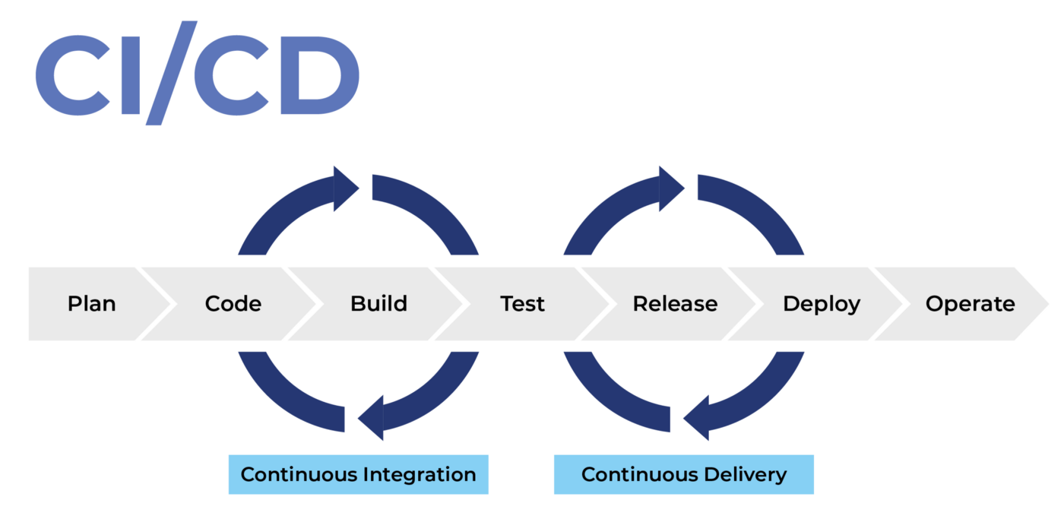
What is CI/CD? CI/CD is a set of engineering practice used by teams to deliver features faster and frequently.

Slide 3
Why CI/CD?
Reduces Risk: Code is tested and deployed more frequently, this reduce the risk level of the project as bugs are detected earlier.
Faster iterations: The gap between the application in production and the one the developer is working on will be much smaller.
Maximum Automation: Reduces human error and also the time and effort for integrations of different code changes.
Seamless Transitions and Easy Rollback: updates/features can be release without interruptions and changes can also be easily rollback.

Slide 4
Why Use CI/CD?
Reduces Cost: issues are prevented before reaching deployment and infrastructure is automatically manage base on needs.
Quick Feedback: Faster releases enable feedback on every change. valuable insight are gain much faster.

